Slide 1
Python Language
John Wang Ph.D.
Notes:
What is the computer language background for each student?
what kind of language they have learned before?
what is the computer skill about how to using computer?
surfer on the internet? find what they want to know, learn what they want to learn?
Let student find Python keyword on internet.

Slide 2


What we will learn in this class?
Install Python Development Package;
Install Visual Code;
Learn how to use Visual Code to do Python programing;
Install GIT source control;
Learn how to use GIT to manage your source code changes;
Learn how to save your work on internet (Github)
Learn Markdown document, and use it for learning notes;
Install Java JDK;
Install Eclipse;
Install Eclipse and PyDev;
Learn how to use Eclipse to write Python code;
What is Python?
Will give you a good idea of the language’s flavor and style;
Basic syntax;
Use file to write Python code;
Read from & Write to file;
Exception and Error handling;
After this course, you may be able to continue learn Python all by yourself.
Github
Notes:
Visual Studio Code: VSCode ➔ Edit Python code
git: ➔source code control
Markdown: ➔Learning notes
Github: ➔Save and Share your work on internet

Slide 3
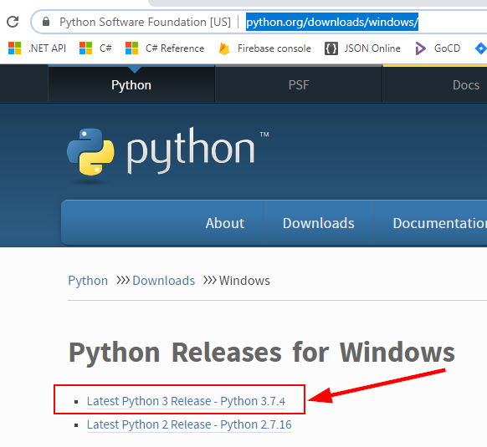
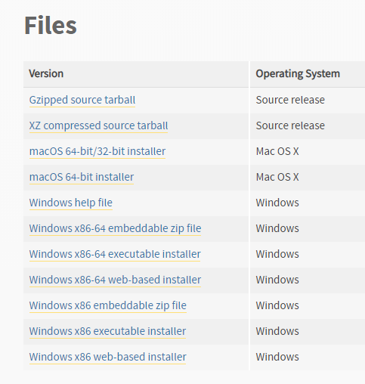
Download Python
https://www.python.org/downloads/windows/
Download installation file: python-3.7.4-amd64.exe
Notes:
check to see if you already have Python installed.
python
which python3
ln -s /path/to/original /path/to/link

Slide 4
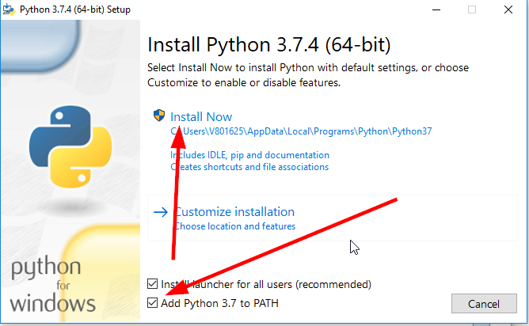
Install Python
After successfully installed, check the installation:
C:\> python --version
Notes:
Online tutorial
After installation, check it
>python
C:\Users\V801625>python
Python 3.7.4 (tags/v3.7.4:e09359112e, Jul 8 2019, 20:34:20) [MSC v.1916 64 bit (AMD64)] on win32
Type "help", "copyright", "credits" or "license" for more information.
https://docs.python.org/3.7/tutorial/index.html
Document
https://docs.python.org/3.7/index.html

Slide 5

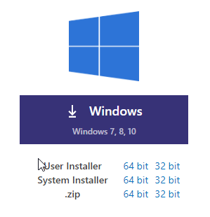
Download and Install Visual Studio Code
https://code.visualstudio.com/download
VSCodeSetup-x64-1.37.1.exe
After successful installation, check the installation
Notes:
Visual Studio Code
very good tutorial for VSCode for Python
https://www.youtube.com/watch?v=06I63_p-2A4
For Windows
https://www.youtube.com/watch?v=-nh9rCzPJ20&t=2066s

Slide 6

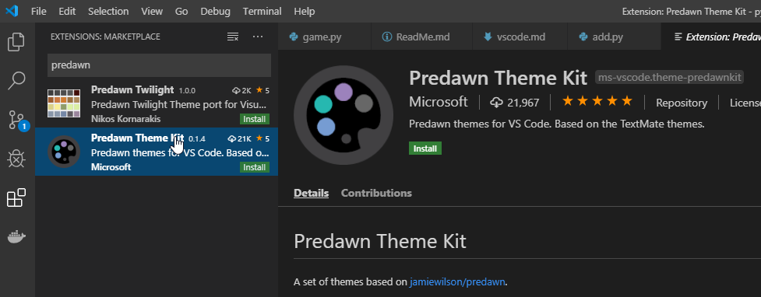
Visual Studio Code Theme
Notes:
Extension
Predawn
ayu

Slide 7
Markdown File
Python Learning Notes.md
Cheat Sheet
https://www.markdownguide.org/cheat-sheet/
Element | Markdown Syntax
Heading | # H1 ## H2 ### H3
Bold | **bold text**
Italic | *italicized text*
Blockquote | > blockquote
Ordered List | 1. First item 2. Second item 3. Third item
Unordered List | - First item - Second item - Third item
Code | `code`
Horizontal Rule | ---
Link | [title](https://www.example.com)
Image | ![alt text](image.jpg)

Slide 8

What is Python?
Python It has efficient high-level data structures and a simple but effective approach to object-oriented programming (OOP).
Script Language (interpreted);
Standard library are freely available;
Free third party Python modules;
Can be used for Game, GUI;
Platform independent;
It has high level data types built in (flexible arrays, dictionaries);
Python allow you split your program into modules that can be reused in other Python programs.
Source code are much shorter than equivalent C, C++ or Java programs.
Notes:
the usual write/compile/test/re-compile cycle is too slow
Best way to learn something new is to try it
https://docs.python.org/3/tutorial/
The Python Standard Library
https://docs.python.org/3/library/index.html#library-index
The Python Language Reference
https://docs.python.org/3/reference/index.html#reference-index
Extending and Embedding the Python Interpreter
https://docs.python.org/3/extending/index.html#extending-index

Slide 9
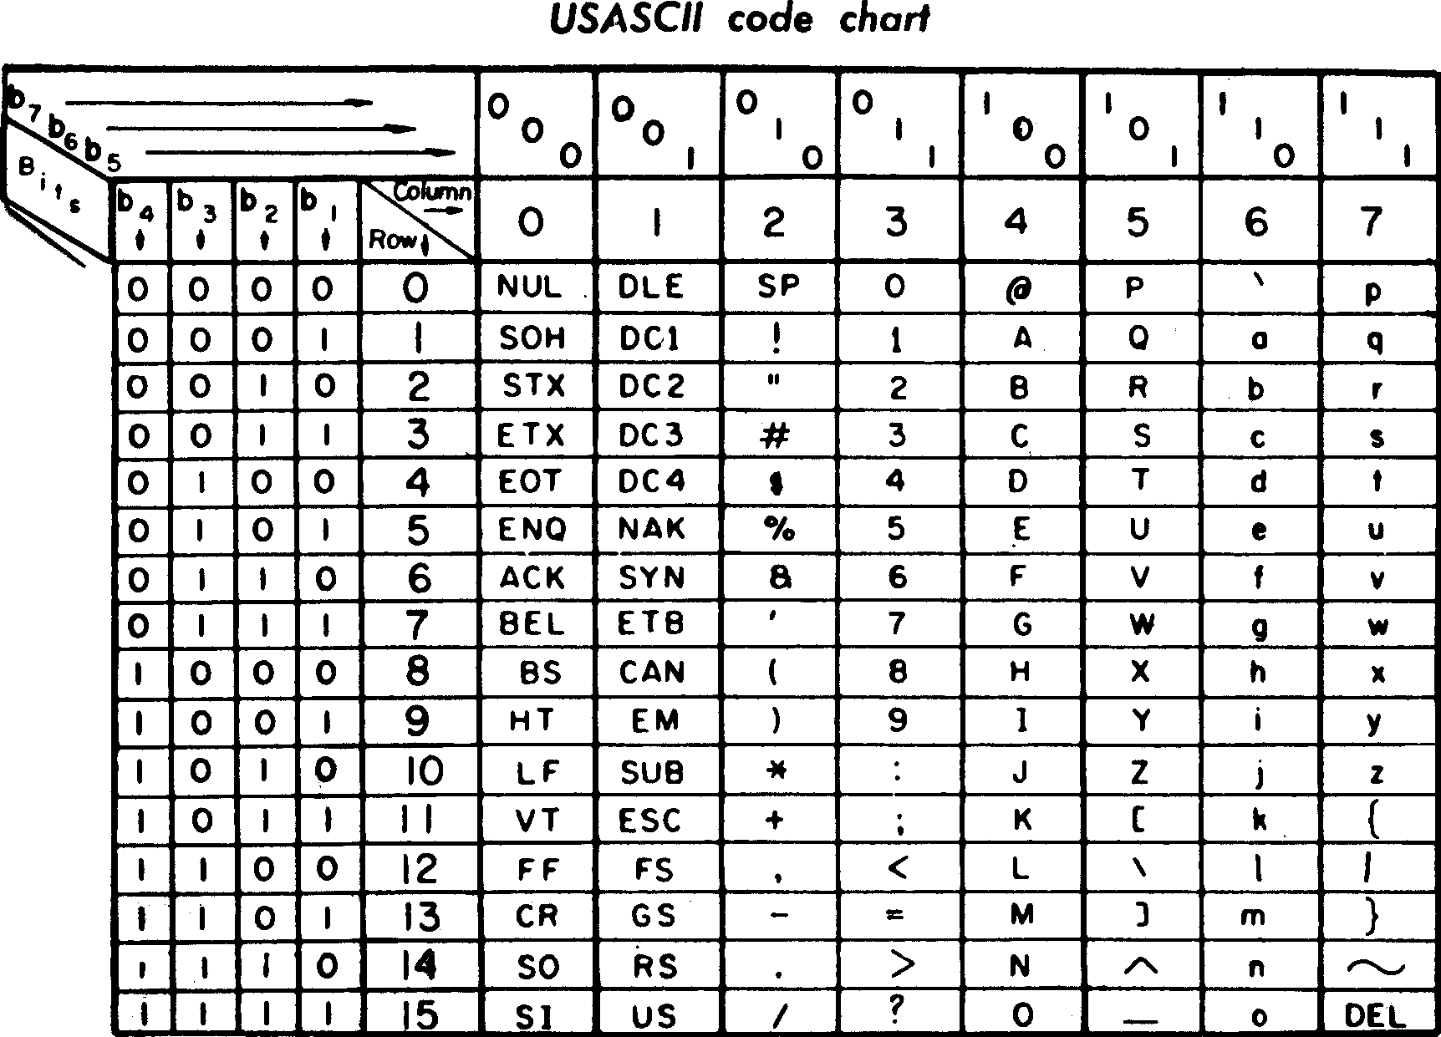


→→
American Standard Code for Information Interchange
Notes:
ASCII: American Standard Code for Information Interchange
A: 0100 0001 == x41
>>>0x41
>>>0b1000001

Slide 11
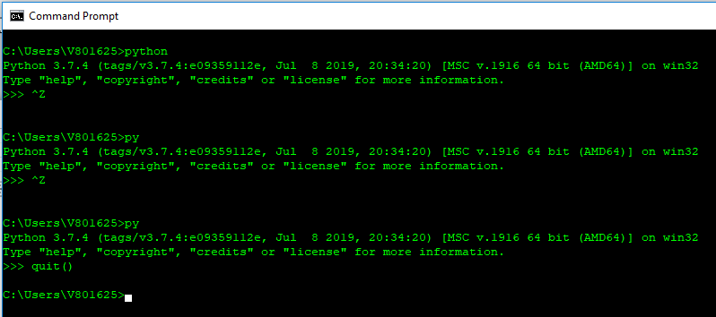
3+4
a=5
b=6
a+b
print(“Hello, the World!”)
Do it by yourself:

Slide 12
Python operators
=
<
+, -, *, /
_
Language Basic
>>> a, b = 0, 1
>>> while a<10:
... print( a +b)
... a ,b = a + 1, a + b
...
Python reserved key words
while
If
elif
for
in
>>> tax = 12.5 / 100
>>> price = 100.5
>>> price * tax
12.5625
>>> price + _ # where _ represent the result of previous value
113.0625
>>> round(_,2)
113.06
>>>
Predefined functions
print()
round()
rang()
Notes:
year = 2019
if year==2019

Slide 13
Get Input from user
>>> input("Please enter your name: ")
>>> x = input("Please enter your name: ")
>>> print('Hello, {}'.format(x))
>>> print("Hello, %s!" % x)
>>> n = input("Please enter a number: ")
Please enter a number: 5
>>> n = int(n)
>>> 5+n

Slide 14
If-elif-else condition
>>> x=int(input("Please enter an integer: "))
Please enter an integer: 30
>>> if x < 0:
... x=0
... print("Negative changed to zero")
... elif x==0:
... print("Zero")
... elif x==1:
... print("Single")
... else:
... print("More")
...
More
>>>
Flow Control
>>> you_are_student = False
>>>
>>> if you_are_student:
... print('I am a student.')
... else:
... print("I am not a student.")
...

Slide 15
“for” loop
>>> words=["cat", "window", "door", "dog"]
>>> for w in words:
... print(w, len(w))
...
cat 3
window 6
door 4
dog 3
>>> for n in range(2, 10):
... for x in range(2, n):
... if n % x == 0:
... print(n, 'equals', x, '*', n//x)
... break
... else:
... print(n, 'is a prime number')
...

Slide 16
“while” loop
count = 0
while count < 5:
print(count)
count += 1
“break” and “continue”
count = 0
while True:
print(count)
count += 1
if count >= 5:
break
for x in range(10):
if x % 2 == 0:
continue
print(x)

Slide 17
Defining Functions
where,
>>> def fib(n):
... a, b=0,1
... while a < n:
... print(a, end=' ')
... a, b = b, a+b
... print()
...
>>> fib(100)
0 1 1 2 3 5 8 13 21 34 55 89
>>>
Key word | Description
def | Definition, language key word
fib | Function name, you name it
(n) | Variable argument n, must be inside the ()
: | Syntax, don’t miss it, or error out, next line must indent
Rest | Function body
After you define a function, you can call it, or execute it.

Slide 18
Using script file
Create a file named fiblib.py
def fib(n):
a, b = 0, 1
while a < n:
print(a, end=' ')
a, b = b, a + b
print()
def fib2(n):
result = []
a, b = 0, 1
while a < n:
result.append(a)
a, b = b, a+b
return result
>>> import fib
>>> fib.fib(1000)
0 1 1 2 3 5 8 13 21 34 55 89 144 233 377 610 987
>>> fib.fib2(1000)
[0, 1, 1, 2, 3, 5, 8, 13, 21, 34, 55, 89, 144, 233, 377, 610, 987]
>>> quit()
>>> from fib_lib import *
>>> fib(500)
0 1 1 2 3 5 8 13 21 34 55 89 144 233 377
>>> fib2(500)
[0, 1, 1, 2, 3, 5, 8, 13, 21, 34, 55, 89, 144, 233, 377]
>>>

Slide 19
>>> import builtins
>>> dir(builtins)
['ArithmeticError', 'AssertionError', 'AttributeError', 'BaseException', 'BlockingIOError', 'BrokenPipeError', 'BufferError', 'BytesWarning', 'ChildProcessError', 'ConnectionAbortedError', 'ConnectionError', 'ConnectionRefusedError', 'ConnectionResetError', 'DeprecationWarning', 'EOFError', 'Ellipsis', 'EnvironmentError', 'Exception', 'False', 'FileExistsError', 'FileNotFoundError', 'FloatingPointError', 'FutureWarning', 'GeneratorExit', 'IOError', 'ImportError', 'ImportWarning', 'IndentationError', 'IndexError', 'InterruptedError', 'IsADirectoryError', 'KeyError', 'KeyboardInterrupt', 'LookupError', 'MemoryError', 'ModuleNotFoundError', 'NameError', 'None', 'NotADirectoryError', 'NotImplemented', 'NotImplementedError', 'OSError', 'OverflowError', 'PendingDeprecationWarning', 'PermissionError', 'ProcessLookupError', 'RecursionError', 'ReferenceError', 'ResourceWarning', 'RuntimeError', 'RuntimeWarning', 'StopAsyncIteration', 'StopIteration', 'SyntaxError', 'SyntaxWarning', 'SystemError', 'SystemExit', 'TabError', 'TimeoutError', 'True', 'TypeError', 'UnboundLo, 'TypeError', 'UnboundLocalError', 'UnicodeDecodeError', 'UnicodeEncodeError', 'UnicodeError', 'UnicodeTrlatEcodeWarningWarning''VanslateError', 'UnicodeWarning', 'UserWarning', 'ValueError', 'Warning', 'WindowsError', 'ZeroDivisionErro_bud, '__doc__''__loade,r', '__build_class__', '__debug__', '__doc__', '__import__', '__loader__', '__name__', '__package__', '__sabs'l', 'breakpes', 'ca',pec__', 'abs', 'all', 'any', 'ascii', 'bin', 'bool', 'breakpoint', 'bytearray', 'bytes', 'callable', 'chr'od'odelattr', 'te', 'evec, 'classmethod', 'compile', 'complex', 'copyright', 'credits', 'delattr', 'dict', 'dir', 'divmod', 'enumerexeer', 'globald', 'inp,ate', 'eval', 'exec', 'exit', 'filter', 'float', 'format', 'frozenset', 'getattr', 'globals', 'hasattr', 'x', e', 'list',ext', 'o',hash', 'help', 'hex', 'id', 'input', 'int', 'isinstance', 'issubclass', 'iter', 'len', 'license', 'list', ', vy', 'quit', 'slice'ta
'locals', 'map', 'max', 'memoryview', 'min', 'next', 'object', 'oct', 'open', 'ord', 'pow', 'print', 'prop'rever', 'tupleerty', 'quit', 'range', 'repr', 'reversed', 'round', 'set', 'setattr', 'slice', 'sorted', 'staticmethod', le'
'str', 'sum', 'super', 'tuple', 'type', 'vars', 'zip']
>>>

Slide 20
Learn by Yourself
>>> dir(__builtins__)
['ArithmeticError', 'AssertionError', 'AttributeError', 'BaseException', 'BlockingIOError', 'BrokenPipeError', 'BufferError', 'BytesWarning', 'ChildProcessError', 'ConnectionAbortedError', 'ConnectionError', 'ConnectionRefusedError', 'ConnectionResetError', 'DeprecationWarning', 'EOFError', 'Ellipsis', 'EnvironmentError',
'Exception', 'False', 'FileExistsError', 'FileNotFoundError', 'FloatingPointError', 'FutureWarning', 'GeneratorExit', 'IOError', 'ImportError', 'ImportWarning', 'IndentationError', 'IndexError', 'InterruptedError', 'IsADirectoryError', 'KeyError', 'KeyboardInterrupt', 'LookupError', 'MemoryError', 'ModuleNotFoundError', 'NameError', 'None', 'NotADirectoryError', 'NotImplemented', 'NotImplementedError', 'OSError', 'OverflowError', 'PendingDeprecationWarning', 'PermissionError', 'ProcessLookupError', 'RecursionError', 'ReferenceError', 'ResourceWarning', 'RuntimeError', 'RuntimeWarning', 'StopAsyncIteration', 'StopIteration', 'SyntaxError', 'SyntaxWarning', 'SystemError', 'SystemExit', 'TabError', 'TimeoutError', 'True', 'TypeError', 'UnboundLocalError', 'UnicodeDecodeError', 'UnicodeEncodeError', 'UnicodeError', 'UnicodeTranslateError', 'UnicodeWarning', 'UserWarning', 'ValueError', 'Warning', 'WindowsError', 'ZeroDivisionError', '_', '__build_class__', '__debug__', '__doc__', '__import__', '__loader__', '__name__', '__package__', '__spec__', 'abs', 'all', 'any', 'ascii', 'bin', 'bool', 'breakpoint', 'bytearray', 'bytes', 'callable', 'chr', 'classmethod', 'compile', 'complex', 'copyright', 'credits', 'delattr', 'dict', 'dir', 'divmod', 'enumerate', 'eval', 'exec', 'exit', 'filter', 'float', 'format', 'frozenset', 'getattr', 'globals', 'hasattr', 'hash', 'help', 'hex', 'id', 'input', 'int', 'isinstance', 'issubclass', 'iter', 'len', 'license', 'list', 'locals', 'map', 'max', 'memoryview', 'min', 'next', 'object', 'oct', 'open', 'ord', 'pow', 'print', 'property', 'quit', 'range', 'repr', 'reversed', 'round', 'set', 'setattr', 'slice', 'sorted', 'staticmethod', 'str', 'sum', 'super', 'tuple', 'type', 'vars', 'zip']
>>>

Slide 21
Learn by Yourself
>>> help(pow)
Help on built-in function pow in module builtins:
pow(x, y, z=None, /)
Equivalent to x**y (with two arguments) or x**y % z (with three arguments)
Some types, such as ints, are able to use a more efficient algorithm when
invoked using the three argument form.
>>>
>>> pow(3,2)
9
>>> pow(3,2,2)
1
>>>
Do It by Yourself:
Find how to use “hex”
Notes:
>>> hex(65)
'0x41'
>>> 0x41
65
>>> 0b01101110
110
>>> hex(110)
'0x6e'

Slide 22
Input and Output
>>> for x in range(1, 11):
... print('{0:2d} {1:3d} {2:4d}'.format(x, x*x, x*x*x))
...
1 1 1
2 4 8
3 9 27
4 16 64
5 25 125
6 36 216
7 49 343
8 64 512
9 81 729
10 100 1000

Slide 23
Create a file named: age.py
def myage(birthYear):
thisYear = 2019
print('My age is ', (thisYear - birthYear))
>>> import age
>>> age.myage(2000)
My age is 19
>>>
Do It by Yourself:
Convert Celsius to Fahrenheit: (Fahrenheit – 32) * 5/9 = Celsius

Slide 24
Read from a File
>>> with open('age.py') as f:
... for line in f:
... print(line, end='')
...
Do It by Yourself:
create a text file;
display the content using Python.

Slide 25
Write to a File
>>> with open(‘add.py', 'w+') as f:
... f.write('print(a + b)\n')
...
11
>>>
Do It by Yourself:
create a text file;
write something to the file using Python.

Slide 26
Use Python File
hello.py
from datetime import date
name = "John Wang"
print("Hello,", name)
print("Hello, %s!" % name)
print("Hello, {0}!".format(name))
today = date.today()
print("Today is {1}. Hello, {0}!".format(name, today))
print("Hello, %s. Today is %s." % (name, today))
print(f"Today is {today}. Hello, {name}!")
Do It by Yourself:
name = input(“Please enter your name: “)

Slide 27

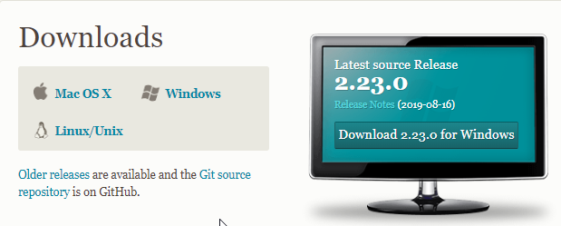
Download Git
Do It by Yourself:
find GIT software on internat;
download it on you hard disk;
install the software;
make sure the software installed correctly

Slide 28
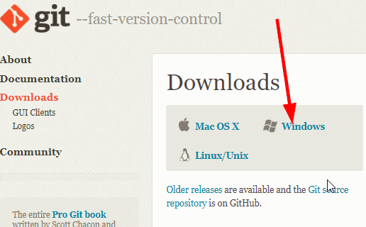
Download and Install Git
Download Git source control software:
https://git-scm.com/downloads
1. Install Git
2. Check the installation
Apply for Github account
https://help.github.com/en/articles/about-github-education-for-students
Create a new repository
Add document into the repository

Slide 29

Frequently Used Git Commands
https://github.com/joshnh/Git-Commands
git commit –a –m “[description]”
git log –oneline
git clone <github url>
git push
git pull
git revert <revision>
git init
Github
git push
git pull
git clone
git commit
.git

Slide 30
Git Repository
C:\Users\V801625\workspace\python>git init
Initialized empty Git repository in C:/Users/V801625/workspace/python/.git/
C:\Users\V801625\workspace\python>git add --all
C:\Users\V801625\workspace\python>git commit -m "first commit"
[master (root-commit) 01d45f7] first commit
5 files changed, 26 insertions(+)
create mode 100644 add.py
create mode 100644 age.py
create mode 100644 fib.py
create mode 100644 fib_lib.py
create mode 100644 test.txt
C:\Users\V801625\workspace\python>git log --oneline
01d45f7 (HEAD -> master) first commit

Slide 31
Append to a File
Available file operation:
open()
close()
read()
write()
closed()
readline()
seek()
>>> with open(‘add.py', ‘a+') as f:
... f.write('print(a + b)\n')
...
11
>>>
>>> with open ('add.py') as f:
... for line in f:
... print(line, end='')
Do It by Yourself:
add more Python code into existing file;
test the file by executing it;
display all contents in the file by Python (for loop);
search on internet, find how to use ‘w’, ‘a’, ‘r’, ‘b’, ’w+’ and so on.
Notes:
Mode Description
'r’ This is the default mode. It Opens file for reading.
'w’ This Mode Opens file for writing. If file does not exist, it creates a new file. If file exists it truncates the file.
'x’ Creates a new file. If file already exists, the operation fails.
'a’ Open file in append mode. If file does not exist, it creates a new file.
't’ This is the default mode. It opens in text mode.
'b’ This opens in binary mode.
'+’ This will open a file for reading and writing (updating)

Slide 32
Mode Description
'r’ This is the default mode. It Opens file for reading.
'w’ This Mode Opens file for writing. If file does not exist, it creates a new file. If file exists it truncates the file.
'x’ Creates a new file. If file already exists, the operation fails.
'a’ Open file in append mode. If file does not exist, it creates a new file.
't’ This is the default mode. It opens in text mode.
'b’ This opens in binary mode.
'+’ This will open a file for reading and writing (updating)

Slide 33
Format output string
Placeholder | Variable
%s | name
>>> name = "John"
>>> print("Hello, %s!" % name)
>>> name = "John"
>>> print("Hello, %s!", name)
>>> name="John"
>>> age=23
>>> print("%s is %d years old." % (name, age))
Do It by Yourself:
display your own name and age on the screen.

Slide 34
Format output string
%s - String (or any object with a string representation, like numbers)
%d - Integers
%f - Floating point numbers
%.<number of digits>f - Floating point numbers with a fixed amount of digits to the right of the dot.
%x/%X - Integers in hex representation (lowercase/uppercase)
Do It by Yourself:
display your own data follow the above instruction on the screen.
a + b = 30
Finish the following code,
Print the following on the screen
data = ("John", "Doe", 53.44)
format_string = "Hello“
print(format_string % data)
Hello John Doe. Your current balance is $53.44.
Notes:
print("PI = %.4f" % 3.1415926)
print("PI = %f" % 3.1415926)
print("PI = %.2f" % 3.1415926)
print("65 = x%x" % 65)
>>> data=("John", "Doe", 53.44)
>>> format_string = "Hello %s %s. Your current balance is $%.2f.“
>>> print(format_string % data)

Slide 35
Format output string
s = "Hey there! what should this string be?“
# Length should be 20
print("Length of s = %d" % len(s))
# First occurrence of "a" should be at index 8
print("The first occurrence of the letter a = %d" % s.index("a"))
# Number of a's should be 2
print("a occurs %d times" % s.count("a"))
# Slicing the string into bits
print("The first five characters are '%s'" % s[:5])
# Start to 5
print("The next five characters are '%s'" % s[5:10])
# 5 to 10
print("The thirteenth character is '%s'" % s[12])
# Just number 12
print("The characters with odd index are '%s'" %s[1::2])
#(0-based indexing)
print("The last five characters are '%s'" % s[-5:])
# 5th-from-last to end# Convert everything to uppercase
print("String in uppercase: %s" % s.upper())

Slide 36
JSon
>>> with open ('test.txt', 'w+') as f:
... json.dump([1, 'simple', 'list'], f)
...
>>>
>>> with open ('test.txt', 'w+') as f:
... json.dump({'student':{'firstName':'John', 'lastName':'Wang', 'id':123456}}, f)
...
>>>
Do It by Yourself:
create complicated json file found on internet to a file;
display the content on the screen.
>>> import json
>>> with open ('widget.json') as f:
... x = json.load(f)
... print(x)
...

Slide 37
Error and Exception
>>> while True print("Hello world")
File "<stdin>", line 1
while True print("Hello world")
^
SyntaxError: invalid syntax
>>>
>>> while True:
... print("Hello, world!")
... break
...
>>> 10 * (1/0)
Traceback (most recent call last):
File "<stdin>", line 1, in <module>
ZeroDivisionError: division by zero
Do It by Yourself:
correct all errors.
>>> print(a + b)
Traceback (most recent call last):
File "<stdin>", line 1, in <module>
NameError: name 'a' is not defined
Notes:
why it is not complain about b?

Slide 38
try - except
>>> while True:
... try:
... x = int(input("Please enter a number: "))
... break
... except ValueError:
... print("Oops!, That was not a valid number. Try again please...")
...
Running result:
>>> import enterNumber
>>> enterNumber.number()
Please enter a number: ds
Oops!, That was not a valid number. Try again please...
Please enter a number: 34
You entered a number: 34
Do It by Yourself:
put above code into a file;
import the file to run the code.

Slide 39
Print your age
def myage(birthYear):
thisYear = 2019
age = (thisYear - birthYear)
print('My age is ', age)
return age
myage(2005)
from datetime import date
today = date.today()
print(today)
print(today.year)
Do It by Yourself:
Modify the function, make it usable for any year without changing code.
Make the function as a module file which can be used in other program.

Slide 40
Classes and Objects
>>> class User:
... pass
...
>>> user1 = User()
>>> user1.first_name = "John"
>>> user1.last_name = "Wang"
>>> print(user1.first_name, user1.last_name)
John Wang
Do It by Yourself:
Create a class, and name it Student
Add first name, last name, math score on it

Slide 41
Classes and Objects
class MyClass:
variable = "blah"
def function(self):
print("This is a message inside the class.")
myobject = MyClass()
print(myobject.variable)
myobject.function()
Do It by Yourself:
Copy above code into a file named “script.py”.
py MyClass.py

Slide 42
Vehicle.py
# define the Vehicle class
class Vehicle:
name = ""
kind = "car"
color = ""
value = 100.00
def description(self):
desc_str = "%s is a %s %s worth $%.2f." % (self.name, self.color, self.kind, self.value)
return desc_str
car1 = Vehicle()
car1.name = "Toyota"
car1.kind = "car"
car1.value = 20000
# your code goes here
# test code
print(car1.description())
print(car2.description())
C:\> py Vehicle.py

Slide 44
Dictionary
phonebook.py
phonebook = {}
phonebook["John"] = 938477566
phonebook["Jack"] = 938377264
phonebook["Jill"] = 947662781
print(phonebook)
phonebook[“Lee”]=123456789
del phonebook[“Jill”]
print(phonebook)
C:\> py phonebook.py

Slide 45

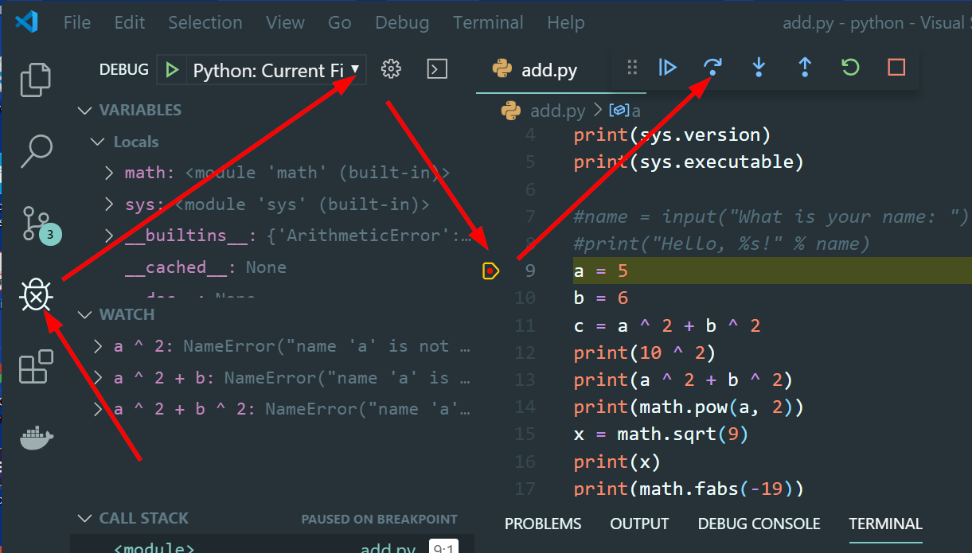

Debug

Slide 46
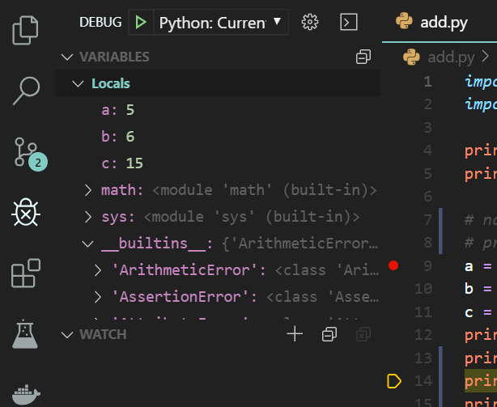
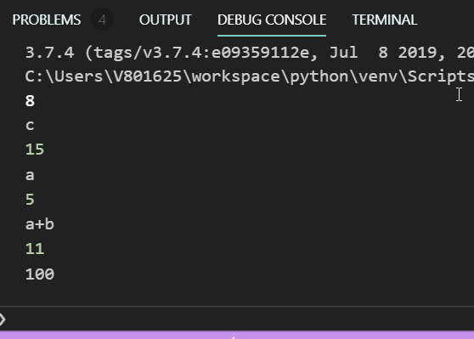
Debug
Start Debug
Local Variables
Break point
Add watch
Current Execute Position

Slide 47
Unit Test
calc.py
def add(a, b):
return a + b
def sub(a, b):
return a - b
def multi(a, b):
return a * b
def divid(a, b):
return a/b

Slide 48
Unit Test
test_calc.py
import unittest
import calc
class TestCalc(unittest.TestCase):
def testAdd(self):
self.assertEqual(calc.add(10, 3), 13)
def testSub(self):
self.assertEqual(calc.sub(10,3), 7)
Do It by Yourself:
Add more test on these two calculation;
Do the unit test on other two math

Slide 49
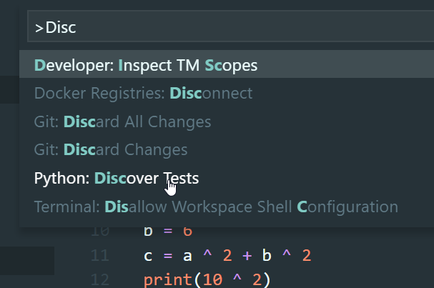
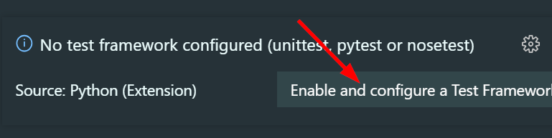
Unit Test

Slide 50

Why Unit Test?
from math import pi
def circle_area(r):
return pi * (r ** 2)
radius = [2, 0, -3, 2 + 5j, True, "radius"]
message = "Area of circle with r = {radius} is {area}."
for r in radius:
a = circle_area(r)
print(message.format(radius=r, area=a))
Fix your code to deal with all strange inputs.
Notes:
unittest.py

Slide 51
import unittest
from circle import circle_area
from math import pi
class TestCircleArea(unittest.TestCase):
def test_area(self):
self.assertAlmostEqual(circle_area(1), pi)
self.assertAlmostEqual(circle_area(0), 0)
self.assertAlmostEqual(circle_area(2.1), pi * 2.1 ** 2)
def test_value(self):
self.assertRaises(ValueError, circle_area, -2)
Should Raise Error Message

Slide 52
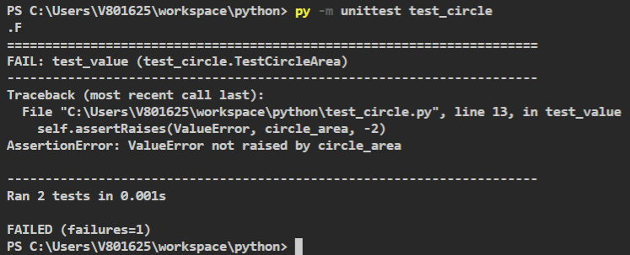

Slide 57
Test Driven Development (TDD)
import unittest
from circle import circle_area
from math import pi
class TestCircleArea(unittest.TestCase):
def test_area(self):
self.assertEqual(circle_area(1), pi)
self.assertEqual(circle_area(0), 0)
self.assertAlmostEqual(circle_area(2.1), pi * 2.1 ** 2)
self.assertEqual(circle_area(1.2), pi*1.2**2)
def test_value(self):
self.assertRaises(ValueError, circle_area, -2)
def test_type(self):
self.assertRaises(TypeError, circle_area, 3+5j)
self.assertRaises(TypeError, circle_area, True)
self.assertRaises(TypeError,circle_area, "radius")

Slide 58
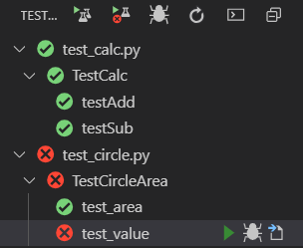
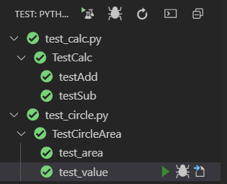

from math import pi
def circle_area(r):
if type(r) not in [int, float]:
raise TypeError("The radius must be a non-negative real number.")
if r < 0:
raise ValueError("The radius cannot be negative.")
return pi * (r**2)
https://docs.python.org/3/library/unittest.html

Slide 59
pip: Python Install Packages
PS C:\Users\V801625\workspace\python> pip install pandas
Collecting pandas
Downloading https://files.pythonhosted.org/packages/b1/69/fcc29820befae2b96fd0b01225577af653e87cd0914634bb2d372a457bd7/pandas-0.25.1-cp37-cp37m-win_amd64.whl (9.2MB)
|████████████████████████████████| 9.2MB 6.8MB/s
Collecting python-dateutil>=2.6.1 (from pandas)
Downloading https://files.pythonhosted.org/packages/41/17/c62faccbfbd163c7f57f3844689e3a78bae1f403648a6afb1d0866d87fbb/python_dateutil-2.8.0-py2.py3-none-any.whl (226kB)
|████████████████████████████████| 235kB 6.4MB/s
Collecting pytz>=2017.2 (from pandas)
Downloading https://files.pythonhosted.org/packages/87/76/46d697698a143e05f77bec5a526bf4e56a0be61d63425b68f4ba553b51f2/pytz-2019.2-py2.py3-none-any.whl (508kB)
|████████████████████████████████| 512kB 6.4MB/s
Collecting numpy>=1.13.3 (from pandas)
Downloading https://files.pythonhosted.org/packages/cb/41/05fbf6944b098eb9d53e8a29a9dbfa20a7448f3254fb71499746a29a1b2d/numpy-1.17.1-cp37-cp37m-win_amd64.whl (12.8MB)
|████████████████████████████████| 12.8MB 3.2MB/s
Collecting six>=1.5 (from python-dateutil>=2.6.1->pandas)
Downloading https://files.pythonhosted.org/packages/73/fb/00a976f728d0d1fecfe898238ce23f502a721c0ac0ecfedb80e0d88c64e9/six-1.12.0-py2.py3-none-any.whl
Installing collected packages: six, python-dateutil, pytz, numpy, pandas
Successfully installed numpy-1.17.1 pandas-0.25.1 python-dateutil-2.8.0 pytz-2019.2 six-1.12.0
PS C:\Users\V801625\workspace\python>

Slide 60
CVS Files
student.csv
#,First Name,Last Name,Score
1432,John,Wang,100
4283,Arron,Lee,85
4285,Williams,Johnson,97
9732,David,Martin,98
>>> import pandas as pd
>>> mydata = pd.read_csv("student.csv")
>>> print(mydata)
>>> print(mydata.columns)
>>> print(mydata['Last Name’])
>>> print(mydata[['#','Score']])
# First Name Last Name Score
0 1432 John Wang 100
1 4283 Arron Lee 85
2 4285 Williams Johnson 97
3 9732 David Martin 98

Slide 61
Plot Data in CVS Files
# read_csv.py import pandas as pd
import matplotlib.pyplot as plt
mydata = pd.read_csv("student.csv")
x = mydata[‘First Name']
y = mydata['Score']
# plot
plt.plot(x,y)
plt.show()

Slide 62
lambda Expression
A Function has NO name. ➔ Anonymous Function
def f(x):
return 3*x + 1
x = 5
print("3 X %d + 1 = %d" % (x, f(x)))
lambda expression
anonymous function
g = lambda x: 3*x + 1
print(g(5))

Slide 63
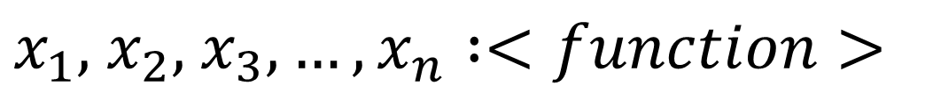
Lambda Expression
lambda x, y : 3*x + 2*y +10
Key word
Separator
Function Body
Variables
lambda
$x_{1},$ $x_{2},$ $x_{3},…,x_{n} :<function>$

Slide 64

lambda Expression with No Input
scifi_authors = ["Isaac Asimov", "Rray Bradbury","Robert Heinlein","Arthus C. Clarke","Frank Herbert","Orson Scott Card", "Douglas Adams","H. G. Wells", "Leigh Brackeet"]
scifi_authors.sort(key=lambda name: name.split(" ")[-1].lower())
print(scifi_authors)
For something simple and only use once.
Do It by Yourself:
sort authors by their first name.
data = [12,32,53,21,111]
data.sort()
print(data)
data.sort(key=lambda d: str(d))
print(data)
Notes:
lambda.py

Slide 65
Sort
>>> help(list.sort)
Help on method_descriptor:
sort(self, /, *, key=None, reverse=False)
Stable sort *IN PLACE*.
Default settings
data = [12,32,53,21,111]
data.sort() # Sort in ascending order
print(data)
data.sort(reverse=True) # Sort in descending order
print(data)
print(sorted(data))
print(sorted("This is a test string from John".split(), key=str.lower))
students = [("John", "B", 15), ("Arron", "A", 12), ("David", "C", 11)]
print(sorted(students, key=lambda s: s[0])) # Sort by student name
Notes:
* can sort anything
IN PLACE means python will not create new list., just change the order of old list.
mysort.py
The readability is little low, how do I know it is sorted by student name?

Slide 66
Sort class: sorted vs. sort
class Student:
def __init__(self, name, grade, age):
self.name = name;
self.grade =grade;
self.age = age;
def __repr__(self):
return repr((self.name, self.age, self.grade))
# return "Name: %s" % self.name
students = [Student("John", "A", 15), Student("David", "B", 13), Student("Helen","C", 16)]
print(sorted(students, key=lambda s: s.age))
print(students)
Do It by Yourself:
def _repr__(self):
return (“Name: %s” % self.name)
Notes:
sortClass.py
sorted() function create a new iterator list.

Slide 67
Map, Filter, Reduce
import math
def area(r):
"""Return area of a circle with radius 'r'."""
return math.pi * (r ** 2)
radius = [2, 1.4, 4.3, 2.5]
print(list(map(area, radius)))
Do It by Yourself:
print 2 digits area
import pi instead of math
use help on area function
write lambda expression for circle area calculation
Notes:
map.py
>>> import map
>>> help(map.area)
from math import pi
radii = [2, 1.4, 4.3, 2.5]
print(list(map(lambda r: pi * r ** 2, radii)))

Slide 68

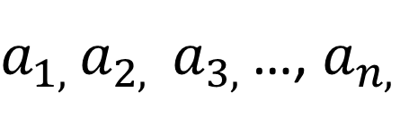
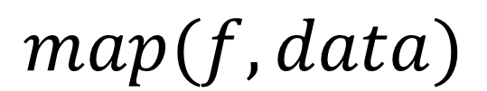
‘map’ Function
data:
$a_{1, }a_{2, }$ $a_{3, }$…, $a_{n, }$
Function:
$$f$$
$$map(f, data)$$

Slide 69
‘map’ Function
data:
$a_{1, }a_{2, }$ $a_{3, }$…, $a_{n, }$
Function:
$$f$$
$$map(f, data)$$

Slide 70

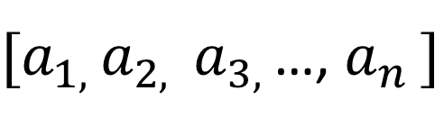

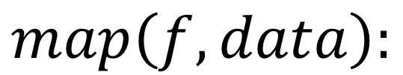
‘map’ Function
data:
${[a}_{1, }a_{2, }$ $a_{3, }$…, $a_{n }]$
Function:
$$f$$
$$map\left(f, data\right):$$
Return iterators over
$f\left(a_{1}\right),$ $f\left(a_{2}\right),$ $f\left(a_{3}\right),$ $…,f\left(a_{n}\right)$

Slide 71
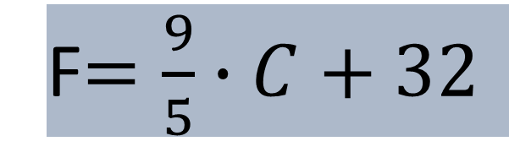
Celsius to Fahrenheit conversion
>>> temps = [("Berlin", 29),("Cairo", 36),("Buenos Aires", 19),("Los Angeles", 26),("Tokyo", 27),("New York", 28),("London", 22),("Beijing", 32)]
c2f = lambda data: (data[0], round((9 / 5) * data[1] + 32, 2))
print(list(map(c2f, temps)))
F$=\frac{9}{5}∙C+32$
Do It by Yourself:
Define a conversion function instead of lambda expression
Write Python code to converting Fahrenheit 20 Celsius
Notes:
Celsius to Fahrenheit conversion

Slide 72
Map, Filter, Reduce
import statistics
data = [1.3, 2.7, 0.8, 4.1, 4.3, -0.1]
avg = statistics.mean(data)
print(avg)
print(list(filter(lambda x: x > avg, data)))
Do It by Yourself:
Modify the code above to get the following output;
Get data list that below the average
The average of the data list is 2.183.
The data above average are [2.7, 4.1, 4.3]

Slide 73

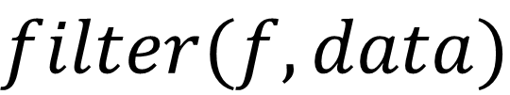
‘filter’ Function
data:
${[a}_{1, }a_{2, }$ $a_{3, }$…, $a_{n }]$
Function:
$$f$$
$$filter(f, data)$$
Return iterators
picked up by function f.

Slide 74
Remove None from Data List
countries = [
"",
"Argentina",
"Brazil",
"Chile",
"",
"Colombia",
"",
None,
"Ecuador",
"China",
"Venezuela",
]
print(list(filter(None, countries)))
“”, 0, 0.0, 0j, [], (), [], False, None
Do It by Yourself:
Try some data “ “, which is couple of space. Could this filter filt out it? Can you write code to filt them as well?

Slide 75
Map, Filter, Reduce
from functools import reduce
data = [2, 3, 5, 7, 11, 13, 17, 19, 23, 29]
multiplier = lambda x, y: x * y
print(reduce(multiplier, data))
Which one do you prefer?
data = [2, 3, 5, 7, 11, 13, 17, 19, 23, 29]
p = 1
for x in data:
p = p * x
print(p)

Slide 76
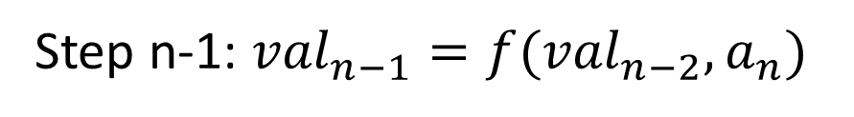

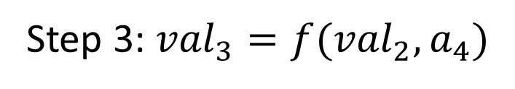
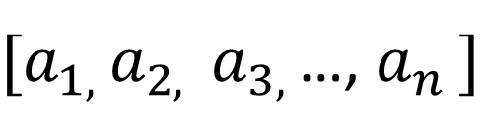
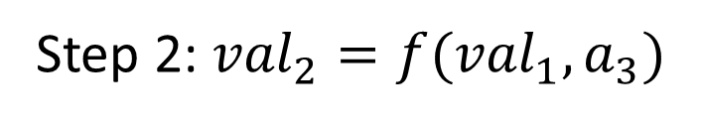
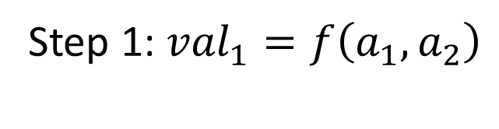
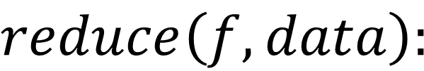
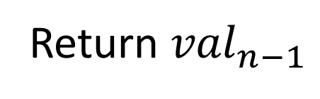
Reduce
‘reduce’ Function
data:
${[a}_{1, }a_{2, }$ $a_{3, }$…, $a_{n }]$
Function:
$$f(x, y)$$
$$reduce\left(f, data\right):$$
Step 1: ${val}_{1}=f\left(a_{1},a_{2}\right)$
Step 2: ${val}_{2}=f({val}_{1},a_{3})$
Step 3: ${val}_{3}=f({val}_{2},a_{4})$
.
.
.
Step n-1: ${val}_{n−1}=f({val}_{n−2},a_{n})$
Return ${val}_{n−1}$

Slide 77
Create Web Application: Hello World!
from flask import Flask
app = Flask(__name__)
@app.route("/")
def hello():
return "<h1>Hello World!</h1>"
if __name__ == '__main__’:
app.run(debug=True)
Do It by Yourself:
Add another route such as “about”
Notes:
pip install flask

Slide 78
Database SQL
from datetime import datetime
from flask_sqlalchemy import SQLAlchemy
from flask import Flask
app = Flask(__name__)
app.config['SQLALCHEMY_DATABASE_URI'] = 'sqlite:///site.db'
db = SQLAlchemy(app)
Load Library
Define application
Define Database
Notes:
pip install flask-sqlalchemy

Slide 79
db = SQLAlchemy(app)
class User(db.Model):
id = db.Column(db.Integer, primary_key=True)
username = db.Column(db.String(20), unique=True, nullable=False)
email = db.Column(db.String(120), unique=True, nullable=False)
image_file = db.Column(db.String(20), nullable=False, default='default.jpg’)
password = db.Column(db.String(60), nullable=False, default='default.jpg’)
posts = db.relationship('Post', backref='author', lazy=True)
def __repr__(self):
return f"User('{self.username}', '{self.email}', '{self.image_file}')"
class Post(db.Model):
id = db.Column(db.Integer, primary_key=True)
title = db.Column(db.String(120), unique=True, nullable=False)
date_posted = db.Column(db.DateTime, nullable=False, default=datetime.utcnow)
content = db.Column(db.Text, nullable=False)
user_id = db.Column(db.Integer, db.ForeignKey('user.id'), nullable=False)
def __repr__(self):
return f"Post('{self.title}', '{self.date_posted}')"

Slide 80
Add data into Database
>>> from flaskblog import db
>>> db.create_all()
>>> from flaskblog import User,Post
>>> user_1 = User(username='John',email='jw@live.com',password='password')
>>> db.session.add(user_1)
>>> user_2 = User(username='Arron',email='aw@live.com',password='password')
>>> db.session.add(user_2)
>>> db.session.commit()
Query Database
>>> User.query.all()
>>> User.query.first()
>>> User.query.filter_by(username='John').all()
>>> User.query.filter_by(username='John').first()
>>> user = User.query.filter_by(username='John').first()

Slide 81
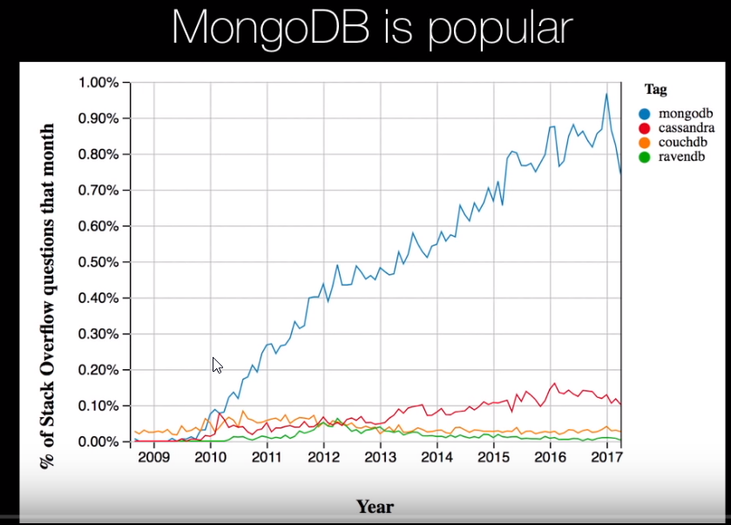

Slide 82
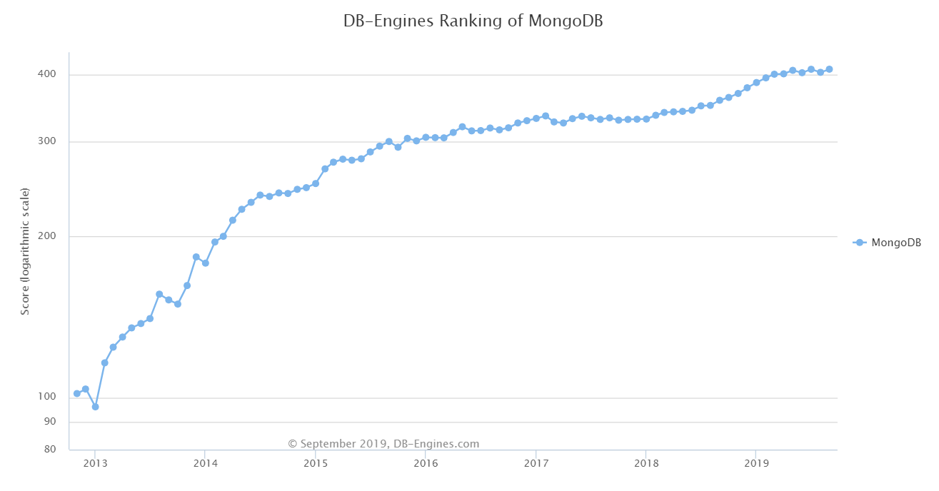
DB-Engines Ranking - Trend of MongoDB Popularity
Notes:
The DB-Engines Ranking ranks database management systems according to their popularity.
This is a partial trend diagram of the complete ranking showing only MongoDB.

Slide 83
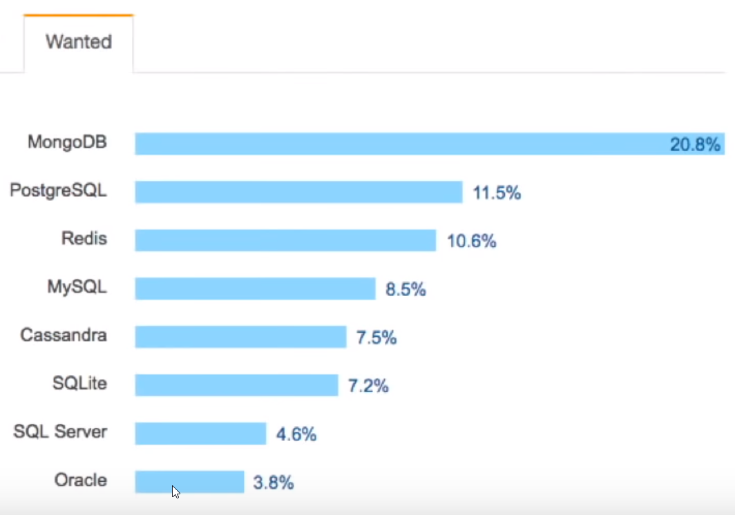
https://www.mongodb.com/download-center/community?jmp=nav
mongodb-win32-x86_64-2012plus-4.2.0-signed.msi
https://github.com/mongodb/mongo

Slide 84

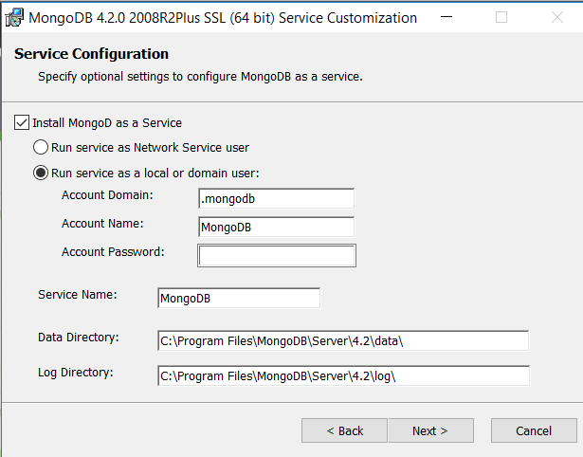

Slide 85
Write Data to MongoDB
pip install pymongo
from pymongo import MongoClient
client = MongoClient("mongodb://localhost:27017")
db = client["huaxia"]
students = db.students
student = {"first_name": "Balaji", "last_name": "Johnson", "grade": "10", "age": 13}
result = students.insert_one(student)
if result.acknowledged:
print("Course Added. The student Id is", result.inserted_id)

Slide 86
Write Data to MongoDB
from pymongo import MongoClient
client = MongoClient("mongodb://localhost:27017")
db = client["huaxia"]
students = db.students
group1 = [
{"first_name": "Arror", "last_name": "Yu", "grade": "10", "age": 14},
{"first_name": "Joe", "last_name": "Johnson", "grade": "8", "age": 13},
{"first_name": "Helen", "last_name": "Martin", "grade": "11", "age": 15},
{"first_name": "Macheal", "last_name": "Williams", "grade": "9", "age": 13}
]
results = students.insert_many(group1)
for id in results.inserted_ids:
print("Student is Added. The Id is", str(id))

Slide 87
Query Data from MongoDB
import pprint
students = students.find();
for s in students
pprint.pprint(s)
students = students.find({
'age’:{
'$gt':14
}
});
for s in students:
pprint.pprint(s)
students = students.find({
'last_name':'Johnson'
});
for s in students:
pprint.pprint(s)
students = students.find().sort([('age', 1)])
for s in students:
pprint.pprint(s)

